Slide 1



Registration Form
Author: Augustin Raja
Created with Pi

Slide 2

CONTENTS
1. Personal Information
2. Course Details
3. Contact Information
4. Sports Interests
5. Submission

Slide 3

01
Personal Information

Slide 4
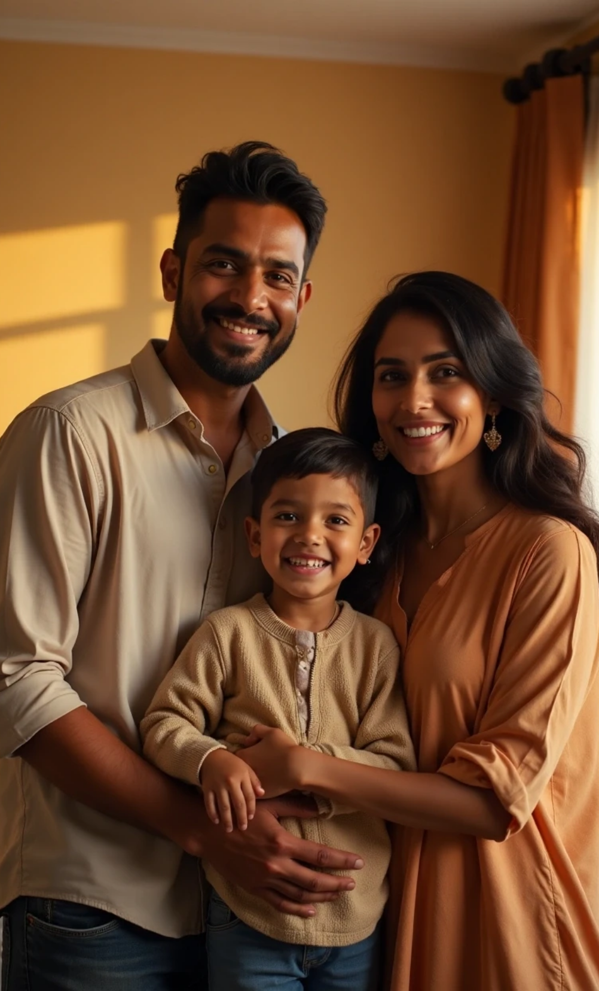
Full Name
RJ Augestin Raja
Father's Name
G Rajadurai
Mother's Name
J Jayachristy

Slide 5

02
Course Details

Slide 6

Course
2nd Year B.Sc Computer Science

Slide 7

03
Contact Information

Slide 8

Phone
7904028774
Email
Augestin333@gmail.com

Slide 9

04
Sports Interests

Slide 10
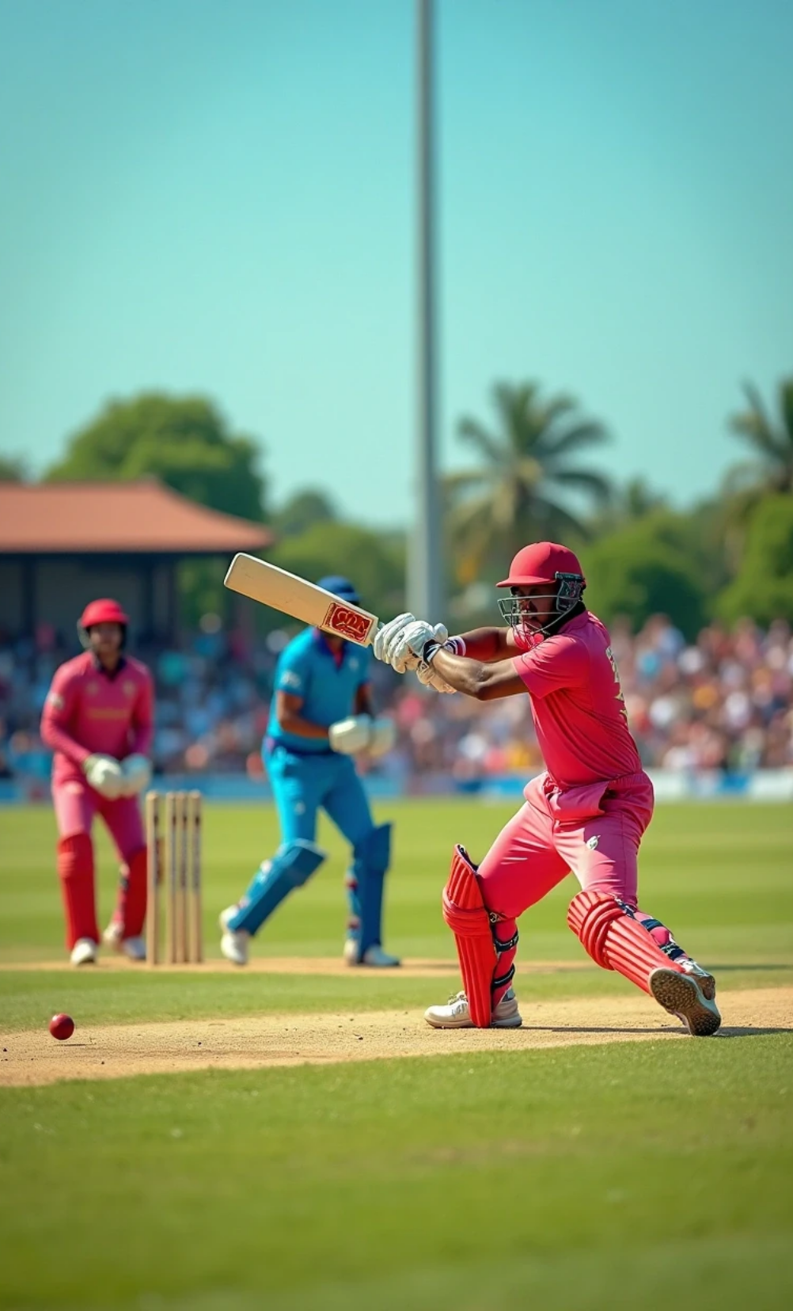
Sports
Cricket
Football
Badminton

Slide 11

05
Submission

Slide 12
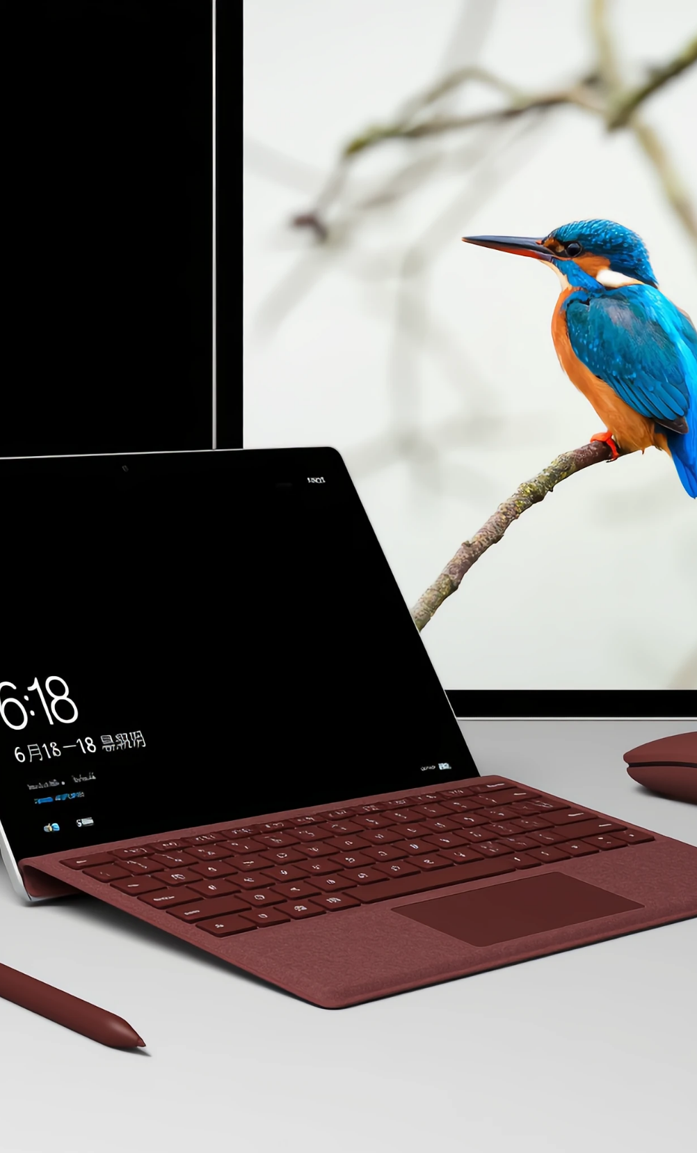
Submission
Submit

Slide 13

Thank You

